Slide 1
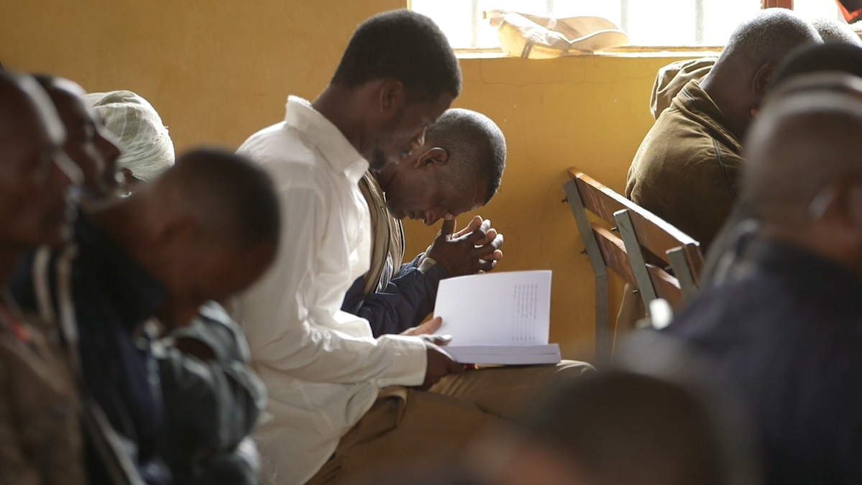
Statement of Faith

Slide 2



Statement of Faith
Core Beliefs

Slide 3
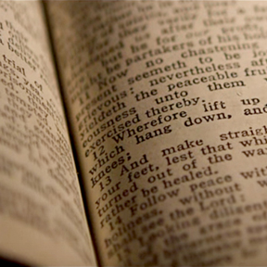
Statement of Faith
Primary Beliefs

Slide 4

Varied non-primary beliefs are OK
Example:
baptism by immersion or by sprinkling

Slide 5
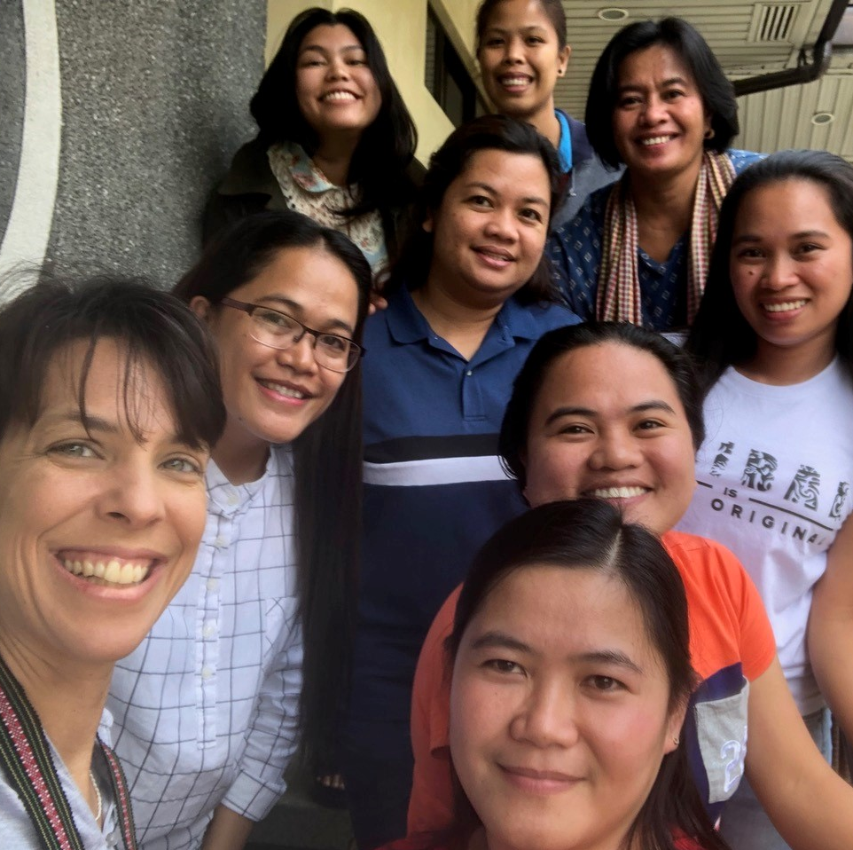
Statement of Faith
encourages:
unity
what is most important
a foundation for working together

